Slide 1
C# Bootcamp
{ Module 3: Classes }
Date will go here

Slide 2
Module Objectives
Become familiar with the components of a method
Call class methods with and without parameters
Use predefined methods in the Console and Math classes
Write your own value and nonvalue-returning class methods (with and without parameters)
Learn about the different methods and properties used for object-oriented development
Write your own instance methods to include constructors, mutators, and accessors
Call instance methods including constructors, mutators, and accessors
Distinguish between value, ref, and out parameter types
Work through a programming example that illustrates the chapter’s concepts

Slide 3
Methods and Behaviors

Slide 4
Anatomy of a Method
Methods and Behaviors
Methods defined inside classes
Group program statements
Based on functionality
Called one or more times
All programs consist of at least one method
Main( )
User-defined method

Slide 5
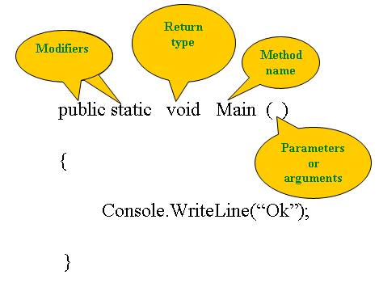
Anatomy of a Method
Methods and Behaviors
Method components

Slide 6
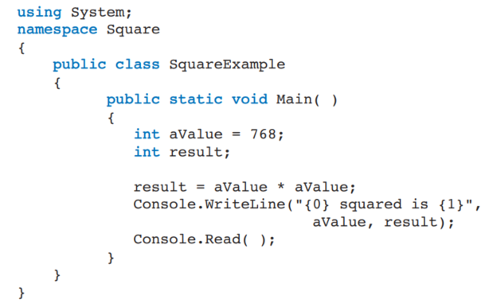
Anatomy of a Method – Sample Code
Methods and Behaviors
Required method

Slide 7
Modifiers
Methods and Behaviors
Appear in method headings
Appear in the declaration heading for classes and other class members
Indicate how it can be accessed
Types of modifiers
Static
Access

Slide 8
Static Modifiers
Methods and Behaviors
Indicates member belongs to the type itself rather than to a specific object of a class
Main( ) must include static in heading
Members of the Math class are static
public static double Pow(double, double)
Static is used in this context to indicate that a method belongs to the type itself rather than to
a specific object of a class
This means that it is not necessary to instantiate an object of the class to use the method member.
Methods that use the static modifier are called class methods
Instance methods require an object

Slide 9
Access Modifiers
Methods and Behaviors
Another type of modifier is an access modifier.
It specifies the level of accessibility for types and their members.
C# includes the following accessibility modifiers:
Public
Protected
internal
protected internal
private

Slide 10
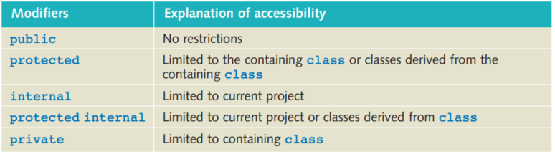
Level of Accessibility
Methods and Behaviors
Public
offers the fewest access limitations; there are basically no restrictions on accessing public members or classes
By specifying a public access, other classes can reuse your classes in different applications.
Protected
is the most restrictive access modifier.
Private members are accessible only within the body of the class in which they are declared.
By defining the data members as private, you restrict access to the data through the members’ methods or properties that you learn about in this module.
Private
Default accessibility level

Slide 11
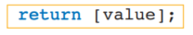
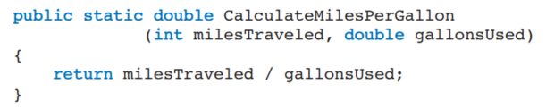
Return Type
Methods and Behaviors
Indicates what type of value is returned when the method is completed
Always listed immediately before method name
void
No value being returned
If a method does not return a value, the void keyword is placed at the return type location in the method heading, as shown in the following line of code:
return statement
Required for all non-void methods
The value returned must be a compatible value—one that either matches the type in the heading or can be stored in that type.
The return statement takes the form:
Compatible value (double) returned
Return type

Slide 12
Method Names
Methods and Behaviors
Follow the rules for creating an identifier
Pascal case style
Action verb or prepositional phrase
Identifiers should be meaningful names that label the overall purpose of the segment of code
Examples
CalculateSalesTax( )
AssignSectionNumber( )
DisplayResults( )
InputAge( )
ConvertInputValue( )

Slide 13
Parameters
Methods and Behaviors
The items inside the parentheses of the method heading are called the parameters, or arguments.
Include data type and an identifier
In method body, reference values using identifier name
Supply unique data to method
Parameter refers to items appearing in the heading
Argument for items appearing in the call
Formal parameters
or arguments, appear in the heading of a method
The formal parameters are like placeholders; they formally indicate what type of data is expected to be sent for the method to use
Actual arguments
or parameters, appear in the call
Think of the actual argument as being the actual data that is sent to the method

Slide 14
Parameters - Sample
Methods and Behaviors
Two formal parameters
Call to method inside Main( ) method
Actual arguments

Slide 15
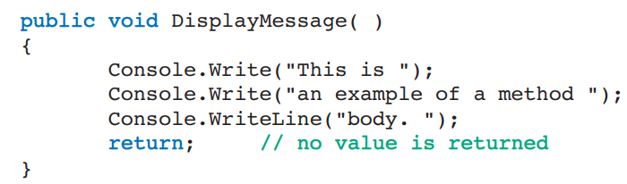
Method Body
Methods and Behaviors
Enclosed in curly braces
Include statements ending in semicolons
Declare variables
Do arithmetic
Call other methods
Value-returning methods must include return statement

Slide 16
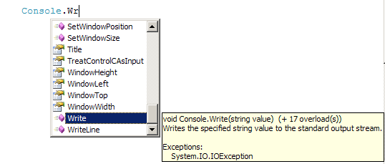
Calling Class Methods
Methods and Behaviors
Invoking a method means calling the method
Call to method that returns no value
Qualifier
Square brackets indicate optional
class or object name
Call to method does not include data type
Use Intellisense

Slide 17
Predefined Methods
Methods and Behaviors
A key feature of the .NET Framework is the extensive class library.
Within the library of classes, each class has a number of predefined methods.
Console class
Overloaded methods
Write( )
WriteLine( )
Read( )
Not overloaded
Returns an integer
After typing the dot, list of members pops up
Method signature(s) and description

Slide 18
Call Parse( )
Methods and Behaviors
Predefined static method
All numeric types have a Parse( ) method
double.Parse(“string number”)
int.Parse(“string number”)
char.Parse(“string number”)
bool.Parse(“string number”)
Expects string argument
Argument must be a number – string format
Returns the number (or char or bool)

Slide 19
Convert Class
Methods and Behaviors
More than one way to convert from one base type to another
System namespace — Convert class — static methods
Convert.ToDouble( )
Convert.ToDecimal( )
Convert.ToInt32( )
Convert.ToBoolean( )
Convert.ToChar( )
int newValue = Convert.ToInt32(stringValue);

Slide 20
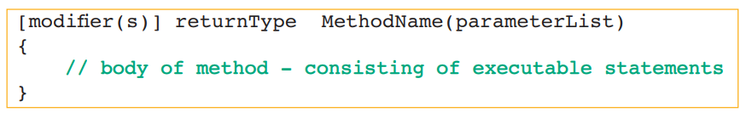
Writing Your Own Class Methods
Methods and Behaviors
There are many classes containing member methods that make up the .NET FCL.
The syntax for defining a method follows.The square brackets used with the modifier indicate an optional entry
User-defined methods in C# can be classified into two categories:
Methods that do not return a value, called void methods
Methods that do return a value, called value-returning methods

Slide 21
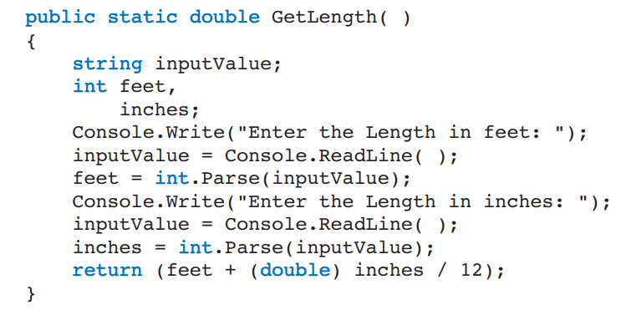
Value-Returning Method
Methods and Behaviors
Return type→ double
Has a return type other than void
Must have a return statement
Compatible value
Zero, one, or more data items may be passed as arguments
Calls can be placed:
In assignment statements
In output statements
In arithmetic expressions
Or anywhere a value can be used
double returned

Slide 22
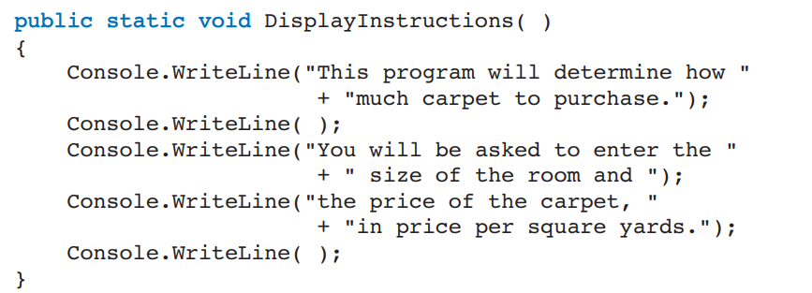
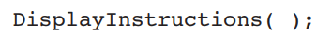
Void Method
Methods and Behaviors
void methods are the simplest to write.
No return statement is needed in the body of the method
A call to this method looks like:
class method

Slide 23
The Object Concept

Slide 24
The Object Concept
The Object Concept
C# is an object-oriented language.
All the code that you wrote for your applications has been placed in a class
Class
Entity
Abstraction
Attributes (data)
Behaviors (processes on the data)
Private member data (fields)
Public method members

Slide 25
Writing Your Own Instance Methods
The Object Concept
Do not use static keyword
Static – class method
To call an instance method, however, an object must be instantiated and associated with the method.
Constructor
are special types of methods used to create objects.
Do not return a value
void is not included
Same identifier as the class name
Overloaded methods
Default constructor
No arguments

Slide 26
Writing Your Own Instance Methods
The Object Concept
Accessor (getter)
Returns the current value
Standard naming convention → prefix with “get”
Accessor for noOfSquareYards is GetNoOfSquareYards( )
Mutators (setters)
Normally includes one parameter
Method body → single assignment statement
Standard naming convention → prefix with ”Set”

Slide 27
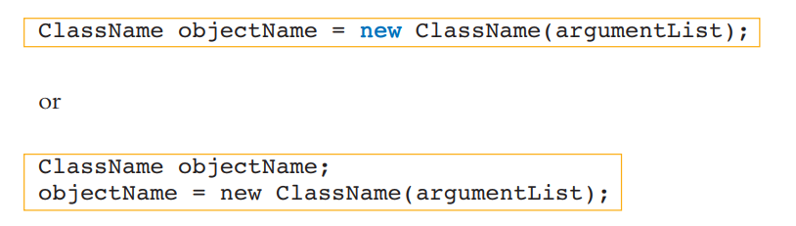
Calling Instance Methods
The Object Concept
Calling the Constructor
Normally, the first method called is the constructor.This is the method that actually creates an object instance of the class.
The syntax for this is:
The keyword new is used as an operator to call constructor methods.

Slide 28
Types of Parameters
The Object Concept
Call by value
Copy of the original value is made
Other types of parameters
ref
out
params
ref and out cause a method to refer to the same variable that was passed into the method

Slide 29
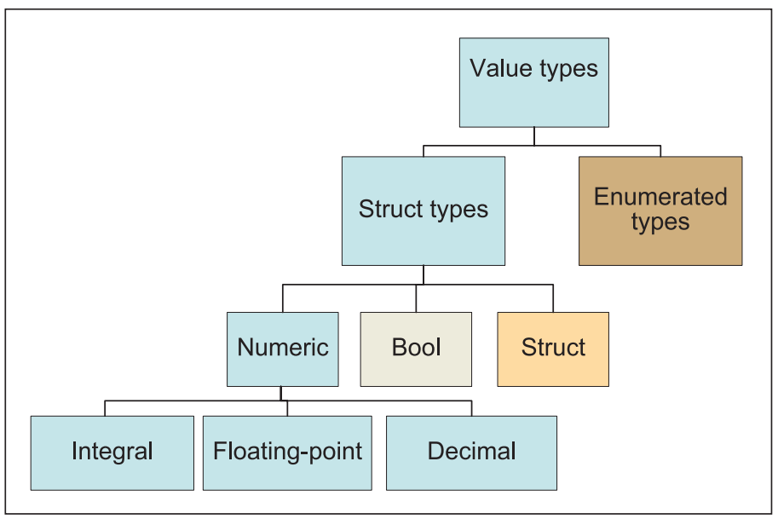
Types of Parameters
The Object Concept
The value types are often called the fundamental data types or primitive data types of the language.
They are the common types needed by most applications.
In C#, these fundamental types are further subdivided into the following categories:
Struct types
Enumerated types

Slide 30
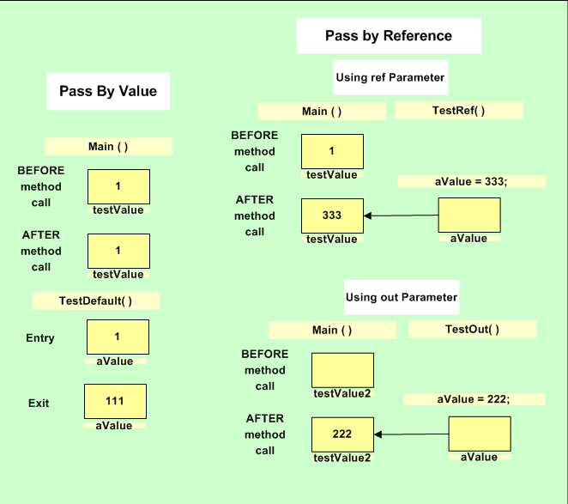
Types of Parameters
The Object Concept
Call by reference versus value

Slide 31
Demo

Slide 32



Questions?

Slide 33
Thank you

